Slide 1
ECEG-5193: Algorithm Analysis and Design
Algorithms of Graph Problems
Algorithms for fundamental graph problems

Slide 2
Maximum Flow
Flow Networks

Slide 3
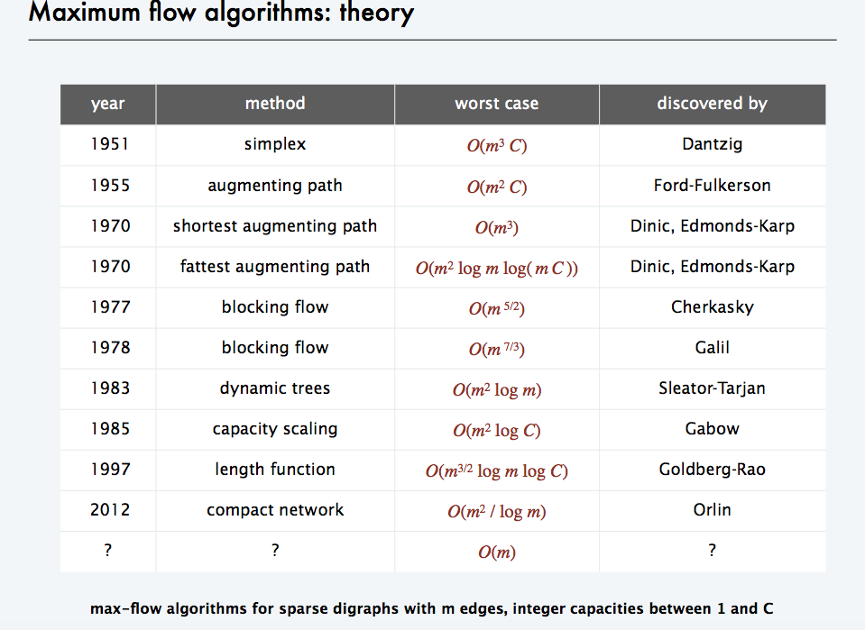

Slide 4
Flow networks:
A flow network G=(V,E): a directed graph, where each edge (u, v)∈E has a nonnegative capacity c(u, v) ≥ 0.
If (u, v)∉E, we assume that c(u, v) = 0.
two distinct vertices : a source s and a sink t.
12
16
20
s
10
9
7
t
4
13
4
14

Slide 5
Flow:
A flow in G: a real-valued function f satisfying the following two properties:
Capacity constraint: For all u, v ∈ V,
we require f(u, v) ≤ c( u, v).
Flow conservation: For all u ∈V-{s, t}, we require
Notes:
a real-valued function f:V*V → R

Slide 6
Net flow and value of a flow f:
The quantity f(u,v) is called the net flow from vertex u to vertex v.
The value of a flow is defined as
The total flow from source to any other vertices.
The same as the total flow from any vertices to the sink.

Slide 7
12/12
11/16
15/20
s
10
t
1/4
4/9
7/7
8/13
4/4
11/14
A flow f in G with value .

Slide 8
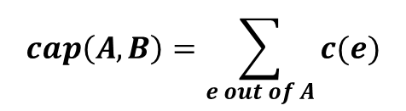
Cuts
Def. An s-t cut is a partition (A, B) of V with
s ∈ A and t ∈ B.
Def. The capacity of a cut (A, B) is:
$$cap\left(A,B\right)=\sum_{e out of A}{c(e)}$$
2
9
5
10
10
4
15
15
s
5
3
8
6
10
t
A
4
6
15
10
15
4
30
7
Capacity = 10 + 5 + 15
= 30
Notes:
8

Slide 9
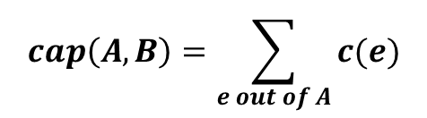
Cuts
Def. An s-t cut is a partition (A, B) of V with s ∈ A and t ∈ B.
Def. The capacity of a cut (A, B) is:
$$cap\left(A,B\right)=\sum_{e out of A}{c(e)}$$
2
9
5
10
4
15
15
10
s
5
3
8
6
10
t
A
4
15
15
6
10
4
30
7
Capacity = 9 + 15 + 8 + 30
= 62
Notes:
9
7->3 not counted

Slide 10
Minimum Cut Problem
Min s-t cut problem. Find an s-t cut of minimum capacity.
2
9
5
10
4
15
15
10
s
5
3
8
6
10
t
A
4
6
15
10
15
4
30
7
Capacity = 10 + 8 + 10
= 28
Notes:
10

Slide 11
Maximum Flow Problem
Max flow problem. Find s-t flow of maximum value.
9
2
9
5
10
1
9
10
4
0
15
15
0
10
4
8
9
s
5
3
8
6
10
t
4
10
capacity
4
0
6
15
0
10
flow
15
14
14
Value = 28
4
30
7
Notes:
11
Equalize inflow and outflow at every intermediate node.
Maximize flow sent from s to t.

Slide 12
Flows and Cuts
Flow value lemma. Let f be any flow, and let (A, B) be any s-t cut. Then, the net flow sent across the cut is equal to the amount leaving s.
6
2
9
5
10
0
6
10
4
4
15
15
0
10
3
8
8
s
5
3
8
6
10
t
A
1
10
4
0
6
15
0
10
15
11
11
Value = 24
4
30
7
Notes:
12

Slide 13
Flows and Cuts
Flow value lemma. Let f be any flow, and let (A, B) be any s-t cut. Then, the net flow sent across the cut is equal to the amount leaving s.
6
2
9
5
10
0
6
10
4
4
15
15
0
10
3
8
8
s
5
3
8
6
10
t
A
1
10
4
0
6
15
0
10
15
11
11
4
30
7
Value = 6 + 0 + 8 - 1 + 11
= 24
Notes:
13
total amount of flow that leaves S minus amount flow that "swirls" back

Slide 14
Flows and Cuts
Flow value lemma. Let f be any flow, and let (A, B) be any s-t cut. Then, the net flow sent across the cut is equal to the amount leaving s.
6
2
9
5
10
0
6
10
4
4
15
15
0
10
3
8
8
s
5
3
8
6
10
t
A
1
10
4
0
6
15
0
10
15
11
11
4
30
7
Value = 10 - 4 + 8 - 0 + 10
= 24
Notes:
14

Slide 15
Flows and Cuts
Weak duality. Let f be any flow, and let (A, B) be any s-t cut. Then the value of the flow is at most the capacity of the cut.
Cut capacity = 30 ⇒ Flow value ≤ 30
2
9
5
10
4
15
15
10
s
5
3
8
6
10
t
A
4
6
15
10
15
4
30
7
Capacity = 30
Notes:
15

Slide 16
Towards a Max Flow Algorithm
Greedy algorithm.
  Start with f(e) = 0 for all edge e ∈ E.
  Find an s-t path P where each edge has f(e) < c(e).
  Augment flow along path P.
  Repeat until you get stuck.
1
0
0
20
10
s
30
0
t
10
20
0
0
Flow value = 0
2
Notes:
16

Slide 17
Towards a Max Flow Algorithm
Greedy algorithm.
  Start with f(e) = 0 for all edge e ∈ E.
  Find an s-t path P where each edge has f(e) < c(e).
  Augment flow along path P.
  Repeat until you get stuck.
1
20
0
0
X
20
10
30
0
20
t
s
X
10
20
0
0
20
X
Flow value = 20
2
Notes:
17

Slide 18
Towards a Max Flow Algorithm
Greedy algorithm.
  Start with f(e) = 0 for all edge e ∈ E.
  Find an s-t path P where each edge has f(e) < c(e).
  Augment flow along path P.
  Repeat until you get stuck.
locally optimality ⇒ global optimality
1
1
20
0
20
10
20
10
20
10
s
30
20
t
s
30
10
t
10
20
10
20
0
20
10
20
greedy = 20
2
opt = 30
2
Notes:
18

Slide 19
Residual Graph
Original edge: e = (u, v) ∈ E.
  Flow f(e), capacity c(e).
Residual edge.
  "Undo" flow sent.
  e = (u, v) and e^{R} = (v, u).
  Residual capacity:
Residual graph: G_{f} = (V, E_{f} ).
  Residual edges with positive residual capacity.
  E_{f} = {e : f(e) < c(e)} ∪ {e^{R} : c(e) > 0}.
capacity
u
17
v
6
flow
residual capacity
u
11
v
6
residual capacity
Notes:
19

Slide 20
Maximum Flow
A flow for a network N is said to be maximum if its value is the largest of all flows for N
The maximum flow problem consists of finding a maximum flow for a given network N
Applications
  Hydraulic systems
  Electrical circuits
  Traffic movements
  Freight transportation

Slide 21
Applications
- Nontrivial applications / reductions.
  - Data mining.
  - Open-pit mining.
  - Project selection.
  - Airline scheduling.
  - Bipartite matching.
  - Baseball elimination.
  - Image segmentation.
  - Network connectivity.
  Network reliability.
  Distributed computing.
  Egalitarian stable matching.
  Security of statistical data.
  Network intrusion detection.
  Multi-camera scene reconstruction.
  Many many more . . .
Notes:
21
Network intrusion detection: http://www.ieee-infocom.org/2003/papers/46_02.PDF

Slide 22
A Simple Flow Algorithm
Example 1

Slide 23
Maximum Flow
v
1/3
2/6
1/1
3/7
t
s
3/3
w
1/1
2/9
4/5
3/5
u
2/2
z
Flow = 2 + 3 + 3 = 1 + 3 + 4 = 8
v
3/3
4/6
1/1
3/7
t
s
3/3
w
1/1
2/9
4/5
3/5
u
2/2
z
Maximum flow = 4 + 3 + 3 = 3 + 3 + 4 = 10

Slide 24
A Simple Flow Algorithm
Initialize all edges of the flow graph with zero flow
Loop while ∃ a path in G_{r} from s to t
  find a path in G_{r} from s to t (augmenting path)
  Add to the flow graph the minimum residual capacity
    from this path
  Reduce the residual capacity of the edges
end Loop
Flow Graph (G_{f})
Residual Graph (G_{r})
v
/3
v
3
/6
6
/1
1
/7
t
7
t
s
/3
s
3
w
w
/1
/9
/5
1
9
5
/5
5
u
/2
z
u
2
z

Slide 25
A Simple Flow Algorithm
Initialize all edges of the flow graph with zero flow
Loop while ∃ a path in G_{r} from s to t
  find a path in G_{r} from s to t (augmenting path)
  Add to the flow graph the minimum residual capacity
    from this path
  Reduce the residual capacity of the edges
end Loop
Flow Graph (G_{f})
Residual Graph (G_{r})
v
0/3
v
3
0/6
6
0/1
1
0/7
t
7
t
s
0/3
s
3
w
w
0/1
0/9
0/5
1
9
5
0/5
5
u
0/2
z
u
2
z

Slide 26
A Simple Flow Algorithm
Initialize all edges of the flow graph with zero flow
Loop while ∃ a path in G_{r} from s to t
  find a path in G_{r} from s to t (augmenting path)
  Add to the flow graph the minimum residual capacity
    from this path
  Reduce the residual capacity of the edges
end Loop
Flow Graph (G_{f})
Residual Graph (G_{r})
v
0/3
v
3
0/6
6
0/1
1
0/7
t
7
t
s
0/3
s
3
w
w
0/1
0/9
0/5
1
9
5
0/5
5
u
0/2
z
u
2
z

Slide 27
A Simple Flow Algorithm
Initialize all edges of the flow graph with zero flow
Loop while ∃ a path in G_{r} from s to t
  find a path in G_{r} from s to t (augmenting path)
  Add to the flow graph the minimum residual capacity
    from this path
  Reduce the residual capacity of the edges
end Loop
Flow Graph (G_{f})
Residual Graph (G_{r})
v
0/3
v
3
0/6
6
0/1
1
0/7
t
7
t
s
0/3
s
3
w
w
0/1
0/9
2/5
1
9
3
2/5
3
u
2/2
z
u
z

Slide 28
A Simple Flow Algorithm
Initialize all edges of the flow graph with zero flow
Loop while ∃ a path in G_{r} from s to t
  find a path in G_{r} from s to t (augmenting path)
  Add to the flow graph the minimum residual capacity
    from this path
  Reduce the residual capacity of the edges
end Loop
Flow Graph (G_{f})
Residual Graph (G_{r})
v
0/3
v
3
0/6
6
0/1
1
0/7
t
7
t
s
0/3
s
3
w
w
0/1
0/9
2/5
1
9
3
2/5
3
u
2/2
z
u
z

Slide 29
A Simple Flow Algorithm
Initialize all edges of the flow graph with zero flow
Loop while ∃ a path in G_{r} from s to t
  find a path in G_{r} from s to t (augmenting path)
  Add to the flow graph the minimum residual capacity
    from this path
  Reduce the residual capacity of the edges
end Loop
Flow Graph (G_{f})
Residual Graph (G_{r})
v
0/3
v
3
0/6
6
0/1
1
0/7
t
7
t
s
3/3
s
w
w
0/1
3/9
5/5
1
6
2/5
3
u
2/2
z
u
z

Slide 30
A Simple Flow Algorithm
Initialize all edges of the flow graph with zero flow
Loop while ∃ a path in G_{r} from s to t
  find a path in G_{r} from s to t (augmenting path)
  Add to the flow graph the minimum residual capacity
    from this path
  Reduce the residual capacity of the edges
end Loop
Flow Graph (G_{f})
Residual Graph (G_{r})
v
0/3
v
3
0/6
6
0/1
1
0/7
t
7
t
s
3/3
s
w
w
0/1
3/9
5/5
1
6
2/5
3
u
2/2
z
u
z

Slide 31
A Simple Flow Algorithm
Initialize all edges of the flow graph with zero flow
Loop while ∃ a path in G_{r} from s to t
  find a path in G_{r} from s to t (augmenting path)
  Add to the flow graph the minimum residual capacity
    from this path
  Reduce the residual capacity of the edges
end Loop
Flow Graph (G_{f})
Residual Graph (G_{r})
v
3/3
v
3/6
3
0/1
1
0/7
t
7
t
s
3/3
s
w
w
0/1
3/9
5/5
1
6
2/5
3
u
2/2
z
u
z

Slide 32
A Simple Flow Algorithm
Initialize all edges of the flow graph with zero flow
Loop while ∃ a path in G_{r} from s to t
  find a path in G_{r} from s to t (augmenting path)
  Add to the flow graph the minimum residual capacity
    from this path
  Reduce the residual capacity of the edges
end Loop
Flow Graph (G_{f})
Residual Graph (G_{r})
v
3/3
v
3/6
3
0/1
1
0/7
t
7
t
s
3/3
s
w
w
0/1
3/9
5/5
1
6
2/5
3
u
2/2
z
u
z

Slide 33
A Simple Flow Algorithm
Initialize all edges of the flow graph with zero flow
Loop while ∃ a path in G_{r} from s to t
  find a path in G_{r} from s to t (augmenting path)
  Add to the flow graph the minimum residual capacity
    from this path
  Reduce the residual capacity of the edges
end Loop
Flow Graph (G_{f})
Residual Graph (G_{r})
v
3/3
v
3/6
3
0/1
1
1/7
t
6
t
s
3/3
s
w
w
1/1
3/9
5/5
6
3/5
2
u
2/2
z
u
z

Slide 34
A Simple Flow Algorithm
Initialize all edges of the flow graph with zero flow
Loop while ∃ a path in G_{r} from s to t
  find a path in G_{r} from s to t (augmenting path)
  Add to the flow graph the minimum residual capacity
    from this path
  Reduce the residual capacity of the edges
end Loop
Flow Graph (G_{f})
Residual Graph (G_{r})
v
3/3
v
3/6
3
0/1
1
1/7
t
6
t
s
3/3
s
w
w
1/1
3/9
5/5
6
3/5
2
u
2/2
z
u
z

Slide 35
A Simple Flow Algorithm
Initialize all edges of the flow graph with zero flow
Loop while ∃ a path in G_{r} from s to t
  find a path in G_{r} from s to t (augmenting path)
  Add to the flow graph the minimum residual capacity
    from this path
  Reduce the residual capacity of the edges
end Loop
Flow Graph (G_{f})
Residual Graph (G_{r})
v
3/3
v
4/6
2
1/1
2/7
t
5
t
s
3/3
s
w
w
1/1
3/9
5/5
6
3/5
2
u
2/2
z
u
z

Slide 36
A Simple Flow Algorithm
Example 2

Slide 37
A Simple Flow Algorithm
Initialize all edges of the flow graph with zero flow
Loop while ∃ a path in G_{r} from s to t
  find a path in G_{r} from s to t (augmenting path)
  Add to the flow graph the minimum residual capacity
    from this path
  Reduce the residual capacity of the edges
end Loop
Flow Graph (G_{f})
Residual Graph (G_{r})
/2
2
v
w
v
w
/2
/3
2
3
s
/1
/4
t
s
1
4
t
/3
/2
3
2
u
z
u
z
/3
3

Slide 38
A Simple Flow Algorithm
Initialize all edges of the flow graph with zero flow
Loop while ∃ a path in G_{r} from s to t
  find a path in G_{r} from s to t (augmenting path)
  Add to the flow graph the minimum residual capacity
    from this path
  Reduce the residual capacity of the edges
end Loop
Flow Graph (G_{f})
Residual Graph (G_{r})
0/2
2
v
w
v
w
0/2
0/3
2
3
s
0/1
0/4
t
s
1
4
t
0/3
0/2
3
2
u
z
u
z
0/3
3

Slide 39
A Simple Flow Algorithm
Initialize all edges of the flow graph with zero flow
Loop while ∃ a path in G_{r} from s to t
  find a path in G_{r} from s to t (augmenting path)
  Add to the flow graph the minimum residual capacity
    from this path
  Reduce the residual capacity of the edges
end Loop
Flow Graph (G_{f})
Residual Graph (G_{r})
0/2
2
v
w
v
w
0/2
3/3
2
s
0/1
3/4
t
s
1
1
t
3/3
0/2
2
u
z
u
z
0/3
3
Algorithm terminates with a sub-optimal flow solution

Slide 40
Backward Flow
Note the following example:
5
S
B
C
T
10
10
10
5
  Let's look at 2 possible sequences of augmenting paths:
    SBT (5), SCT (5), SBCT (5)
      Total Flow is 15
    SBCT (10), ????
      We seem to be stuck, since there is no forward path from S to T
      Yet the choice of paths should not affect our answer

Slide 41
Backward Flow
Note the following example:
5
S
B
C
T
10
10
10
10
5
5
10
10
10
S
B
C
T
10
5
5
10
5/10
10
S
B
C
T
15
5
5
5
10
S
B
C
T
15
10
5
5

Slide 42
Maximum-flow problem
Given a flow network G with source s and sink t
Find a flow of maximum value from s to t.
How to solve it efficiently?

Slide 43
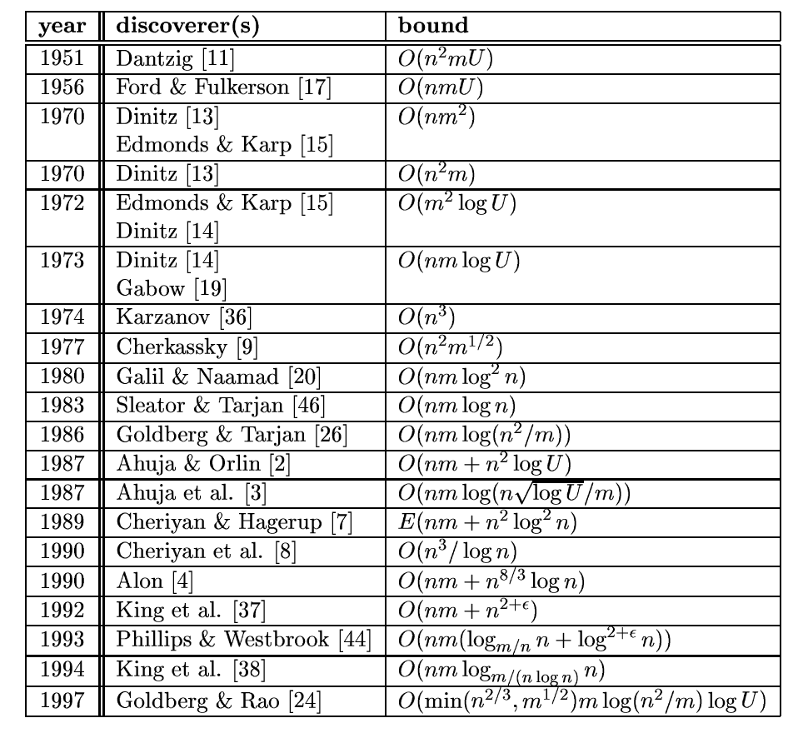
Some more history
Notes:
43
From: http://citeseer.ifi.unizh.ch/goldberg98recent.html

Slide 44
Augmenting Path Algorithm
Augment(f, c, P) {
b ← bottleneck(P)
foreach e ∈ P {
if (e ∈ E) f(e) ← f(e) + b
else f(e^{R}) ← f(e) - b
}
return f
}
forward edge
reverse edge
Ford-Fulkerson(G, s, t, c) {
foreach e ∈ E f(e) ← 0
G_{f} ← residual graph
while (there exists augmenting path P) {
f ← Augment(f, c, P)
update G_{f}
}
return f
}
Notes:
44

Slide 45
Ford-Fulkerson’s Algorithm
Initialize all edges of the flow graph with zero flow
Loop while ∃ a path in G_{r} from s to t
  find a path in G_{r} from s to t (augmenting path)
  Add to the flow graph the minimum residual capacity
    from this path
  Reduce the residual capacity of the edges
  Add a reversed path in the residual graph
end Loop
Residual Graph (G_{r})
Flow Graph (G_{f})
0/2
2
v
w
v
w
0/2
0/3
2
3
s
0/1
0/4
t
s
1
4
t
0/3
0/2
3
2
u
z
u
z
0/3
3

Slide 46
Ford-Fulkerson’s Algorithm
Initialize all edges of the flow graph with zero flow
Loop while ∃ a path in G_{r} from s to t
  find a path in G_{r} from s to t (augmenting path)
  Add to the flow graph the minimum residual capacity
    from this path
  Reduce the residual capacity of the edges
  Add a reversed path in the residual graph
end Loop
Residual Graph (G_{r})
Flow Graph (G_{f})
0/2
2
v
w
v
w
0/2
3/3
2
-3
s
0/1
3/4
t
s
1
1
t
-3
3/3
0/2
-3
2
u
z
u
z
0/3
3

Slide 47
Ford-Fulkerson’s Algorithm
Initialize all edges of the flow graph with zero flow
Loop while ∃ a path in G_{r} from s to t
  find a path in G_{r} from s to t (augmenting path)
  Add to the flow graph the minimum residual capacity
    from this path
  Reduce the residual capacity of the edges
  Add a reversed path in the residual graph
end Loop
Residual Graph (G_{r})
Flow Graph (G_{f})
0/2
2
v
w
v
w
0/2
3/3
2
-3
s
0/1
3/4
t
s
1
1
t
-3
3/3
0/2
-3
2
u
z
u
z
0/3
3

Slide 48
Ford-Fulkerson’s Algorithm
Initialize all edges of the flow graph with zero flow
Loop while ∃ a path in G_{r} from s to t
  find a path in G_{r} from s to t (augmenting path)
  Add to the flow graph the minimum residual capacity
    from this path
  Reduce the residual capacity of the edges
  Add a reversed path in the residual graph
end Loop
Residual Graph (G_{r})
Flow Graph (G_{f})
2/2
-2
v
w
v
w
2/2
3/3
-2
-3
s
0/1
1/4
t
s
1
3
t
-1
3/3
2/2
-3
-2
-2
u
z
u
z
2/3
1

Slide 49
Analysis
Each augmenting path increases the flow value by at least 1.
Let |f*| is a maximum flow, then in the worst case, Ford-Fulkerson’s algorithm performs |f*| flow augmentations.
Finding an augmenting path and augmenting the flow takes O(n + m) time
The running time of Ford-Fulkerson’s algorithm is O(|f*|(n + m))

Slide 50
Analysis
v
50
50
Classic worst case
example:
s
1
t
50
50
u
Flow Graph (G_{f})
Residual Graph (G_{r})
v
v
0/50
1/50
50
49
s
s
-1
1/1
t
-1
-1
t
1/50
0/50
49
50
u
u

Slide 51
Analysis
v
50
50
Classic worst case
example:
s
1
t
50
50
u
Flow Graph (G_{f})
Residual Graph (G_{r})
v
v
1/50
1/50
49
49
-1
s
s
-1
0/1
t
1
t
-1
-1
1/50
1/50
49
49
u
u

Slide 52
Ford-Fulkerson Algorithm
Demo

Slide 53
Ford-Fulkerson Algorithm
0
flow
2
4
4
capacity
G:
0
0
0
10
2
0
8
6
0
10
0
0
0
s
10
3
9
5
10
t
Flow value = 0

Slide 54
Ford-Fulkerson Algorithm
0
flow
2
4
4
capacity
G:
8
0
0
X
0
8
X
10
2
0
8
6
0
10
0
8
0
0
X
s
10
3
9
5
10
t
8
Flow value = 0
2
4
4
residual capacity
G_{f}:
10
2
8
6
10
s
10
3
9
5
10
t

Slide 55
Ford-Fulkerson Algorithm
0
2
4
4
G:
10
8
0
X
8
10
2
0
8
6
0
10
X
2
0
10
8
0
2
X
X
s
10
3
9
5
10
t
10
Flow value = 8
2
4
4
G_{f}:
8
2
2
8
6
10
s
10
3
9
5
2
t
8

Slide 56
Ford-Fulkerson Algorithm
0
2
4
4
G:
0
6
10
8
X
8
6
0
10
2
2
X
10
6
0
6
10
X
2
8
X
s
10
3
9
5
10
t
16
Flow value = 10
2
4
4
G_{f}:
10
2
8
6
10
s
10
3
7
5
10
t
2

Slide 57
Ford-Fulkerson Algorithm
0
2
X
2
4
4
G:
6
8
10
8
X
10
2
2
8
6
6
10
X
0
6
8
10
X
8
18
s
10
3
9
5
10
t
Flow value = 16
2
4
4
G_{f}:
6
10
2
8
6
4
s
4
3
1
5
10
t
6
8

Slide 58
Ford-Fulkerson Algorithm
2
3
X
2
4
4
G:
8
9
10
8
7
X
X
10
2
0
8
6
6
10
8
9
10
X
8
9
X
s
10
3
9
5
10
t
19
Flow value = 18
2
2
2
4
G_{f}:
8
10
2
8
6
2
s
2
3
1
5
10
t
8
8

Slide 59
Ford-Fulkerson Algorithm
3
2
4
4
G:
10
7
9
10
2
0
8
6
6
10
9
9
10
s
10
3
9
5
10
t
Flow value = 19
3
2
1
4
G_{f}:
9
1
10
2
7
6
1
s
1
3
9
5
10
t
9

Slide 60
Ford-Fulkerson Algorithm
3
2
4
4
G:
10
7
9
10
2
0
8
6
6
10
9
9
10
s
10
3
9
5
10
t
Cut capacity = 19
Flow value = 19
3
2
1
4
G_{f}:
9
1
10
2
7
6
1
s
1
3
9
5
10
t
9

Slide 61
Time complexity
If each c(e) is an integer, then time complexity is O(|E|f*), where f* is the maximum flow.
Reason: each time the flow is increased by at least one.
This might not be a polynomial time algorithm since f* can be represented by log (f*) bits. So, the input size might be log(f*).

Slide 62
Choosing Good Augmenting Paths
Notes:
62

Slide 63
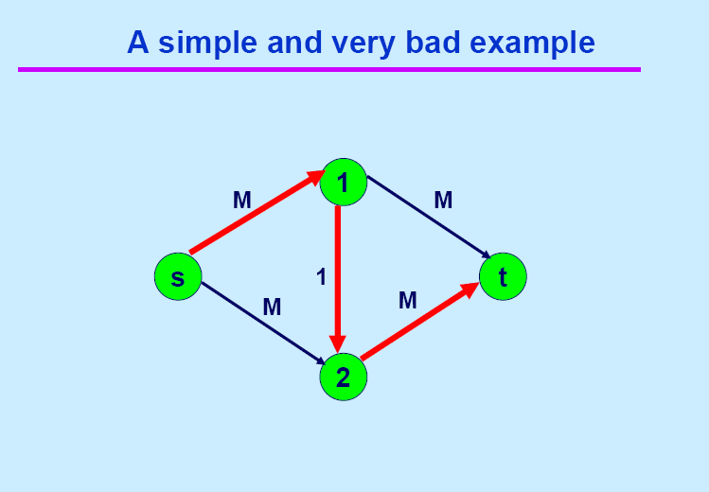

Slide 64
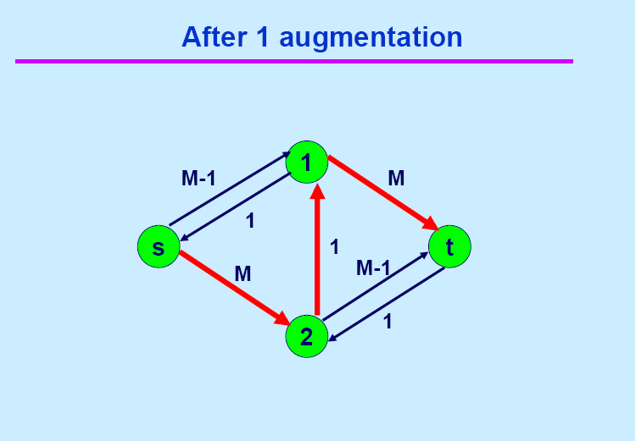

Slide 65
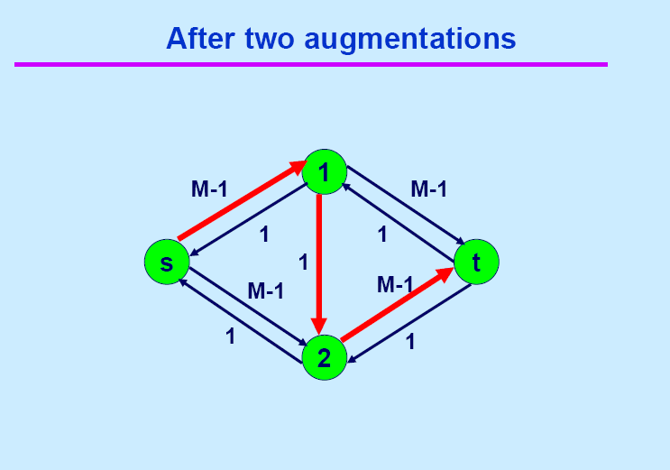

Slide 66
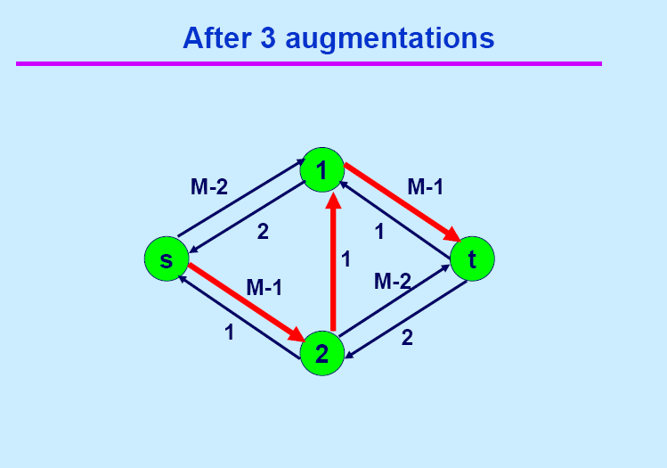

Slide 67
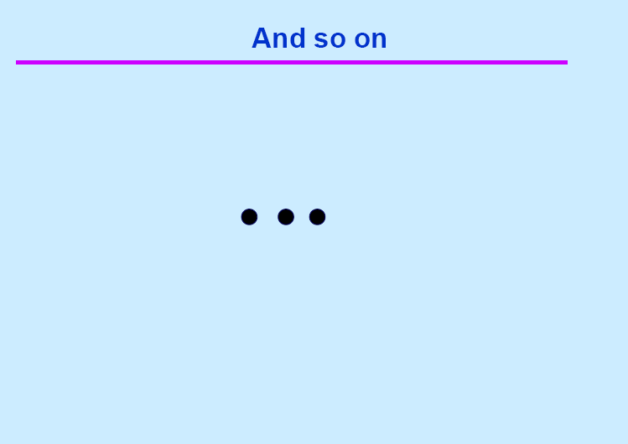

Slide 68
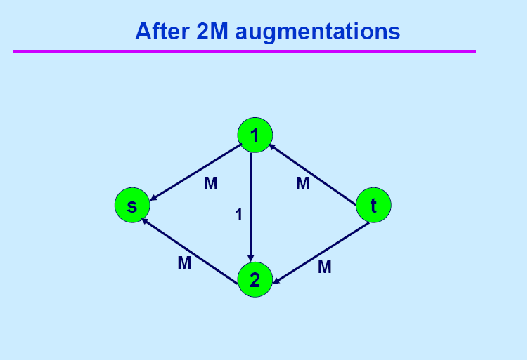

Slide 69
Ford-Fulkerson: Exponential Number of Augmentations
Q. Is generic Ford-Fulkerson algorithm polynomial in input size?
A. No. If max capacity is C, then algorithm can take C iterations.
m, n, and log C
1
1
1
0
0
1
0
0
X
X
X
1
C
C
C
C
1
0
t
1
0
1
0
t
s
X
1
s
X
X
C
C
C
C
0
0
1
0
0
1
X
1
X
X
2
2
Notes:
69

Slide 70
Choosing Good Augmenting Paths
Use care when selecting augmenting paths.
  Some choices lead to exponential algorithms.
  Clever choices lead to polynomial algorithms.
  If capacities are irrational, algorithm not guaranteed to terminate!
Goal: choose augmenting paths so that:
  Can find augmenting paths efficiently.
  Few iterations.
Notes:
70

Slide 71
Choosing Good Augmenting Paths
Choose augmenting paths with: [Edmonds-Karp 1972, Dinitz 1970]
  Max bottleneck capacity.
  Sufficiently large bottleneck capacity.
  Fewest number of edges.
Notes:
71

Slide 72
Capacity Scaling
Intuition. Choosing path with highest bottleneck capacity increases flow by max possible amount.
  Don't worry about finding exact highest bottleneck path.
  Maintain scaling parameter Δ.
  Let G_{f} (Δ) be the subgraph of the residual graph consisting of only arcs with capacity at least Δ.
4
4
110
102
110
102
s
1
t
s
t
122
170
122
170
2
2
G_{f}
G_{f} (100)
Notes:
72

Slide 73
Capacity Scaling
Scaling-Max-Flow(G, s, t, c) {
foreach e ∈ E f(e) ← 0
Δ ← smallest power of 2 greater than or equal to max c
G_{f} ← residual graph
while (Δ ≥ 1) {
G_{f}(Δ) ← Δ-residual graph
while (there exists augmenting path P in G_{f}(Δ)) {
f ← augment(f, c, P)
update G_{f}(Δ)
}
Δ ← Δ / 2
}
return f
}
Notes:
73

Slide 74
Capacity Scaling: Correctness
Assumption. All edge capacities are integers between 1 and C.
Integrality invariant. All flow and residual capacity values are integral.
Correctness. If the algorithm terminates, then f is a max flow.
Pf.
  By integrality invariant, when Δ = 1 ⇒ G_{f}(Δ) = G_{f}.
  Upon termination of Δ = 1 phase, there are no augmenting paths. ▪
Notes:
74

Slide 75
Capacity Scaling: Running Time
Lemma 1. The outer while loop repeats 1 + ⎡log₂ C⎤ times.
Pf. Initially Δ < C. Δ drops by a factor of 2 each iteration and never gets below 1.
Lemma 2. Let f be the flow at the end of a Δ-scaling phase. Then the value of the maximum flow is at most v(f) + m Δ.
Lemma 3. There are at most 2m augmentations per scaling phase.
  Let f be the flow at the end of the previous scaling phase.
  L2 ⇒ v(f*) ≤ v(f) + m (2Δ).
  Each augmentation in a Δ-phase increases v(f) by at least Δ.
Theorem. The scaling max-flow algorithm finds a max flow in O(m log C) augmentations. It can be implemented to run in O(m² log C) time. ▪
proof on next slide
Notes:
75

Slide 76
Capacity Scaling: Running Time
Lemma 2. Let f be the flow at the end of a Δ-scaling phase. Then value of the maximum flow is at most v(f) + m Δ.
Pf. (almost identical to proof of max-flow min-cut theorem)
  We show that at the end of a Δ-phase, there exists a cut (A, B) such that cap(A, B) ≤ v(f) + m Δ.
  Choose A to be the set of nodes reachable from s in G_{f}(Δ).
  By definition of A, s ∈ A.
  By definition of f, t ∉ A.
A
B
t
s
original network
Notes:
76
intuition: f is max flow in G_{f}(Δ). Adding back arc with capacity less than Δ can only increase capacity of cut by at most mΔ.

Slide 77
Capacity Scaling
S
5
S
6
11
S
1
7
1
S
14
12
S
10
S
Max(14, 6, 1, 5, 7, 10, 1, 12, 11) =

Slide 78
Capacity Scaling
S
5
S
6
11
S
1
7
1
S
14
12
S
10
S
Max(14, 6, 1, 5, 7, 10, 1, 12, 11) =
14

Slide 79
Capacity Scaling
S
5
S
6
11
S
1
7
1
S
14
12
S
10
S
Max(14, 6, 1, 5, 7, 10, 1, 12, 11) =
14
Δ = 2³ = 8; since, 2⁴ =16
Find an augmenting path whose edges are ≥ Δ (= 8 )

Slide 80
Capacity Scaling
S
5
S
6
11
S
1
7
1
S
14
12
S
10
S
Max(14, 6, 1, 5, 7, 10, 1, 12, 11) =
14
Δ = 2³ = 8; since, 2⁴ =16
Find an augmenting path whose edges are ≥ Δ (= 8 )

Slide 81
Capacity Scaling
S
5
S
6
11
S
1
7
1
S
10
10
14
12
10
10
10
S
10
S
10

Slide 82
Capacity Scaling
S
5
S
6
11
S
1
7
1
S
10
10
14
12
10
10
10
S
10
S
10
Δ = Δ /2 = 8/2 = 4
Find an augmenting path whose edges are ≥ 4

Slide 83
Capacity Scaling
S
5
S
6
11
S
1
7
1
S
10
10
14
12
10
10
10
S
10
S
10
Δ = Δ /2 = 8/2 = 4
Find an augmenting path whose edges are ≥ 4

Slide 84
Capacity Scaling
S
5
S
6
11
S
1
7
1
S
10
10
14
12
10
10
10
S
10
S
10
Δ = Δ /2 = 8/2 = 4
Find an augmenting path whose edges are ≥ 4

Slide 85
Capacity Scaling
5
5
S
5
S
5
5
5
5
6
11
S
1
7
1
S
10
10
14
12
10
10
10
S
10
S
10

Slide 86
Capacity Scaling
5
5
S
5
S
5
5
5
5
6
11
S
1
7
1
S
10
10
14
12
10
10
10
S
10
S
10
Δ = 4
Find an augmenting path whose edges are ≥ 4

Slide 87
Capacity Scaling
5
S
5
5
S
5
5
5
11
5
6
S
1
7
1
S
10
10
14
12
10
10
10
S
10
S
10
Δ = Δ /2 = 8/2 = 4
Find an augmenting path whose edges are ≥ 4

Slide 88
Capacity Scaling
5
S
5
S
5
9
5
5
6
11
9
4
S
1
7
1
S
4
10
14
14
12
14
10
10
S
10
S
10

Slide 89
Capacity Scaling
5
S
5
S
5
9
5
5
6
11
9
4
S
1
7
1
S
4
10
14
14
12
14
10
10
S
10
S
10
Δ = Δ /2 = 4/2 = 2
Find an augmenting path whose edges are ≥ 2

Slide 90
Capacity Scaling
5
S
5
S
5
9
5
5
6
11
9
4
S
1
7
1
S
4
10
14
14
12
14
10
10
S
10
S
10
NO augmenting path whose edges are ≥ 2

Slide 91
Capacity Scaling
5
S
5
S
5
9
5
5
6
11
9
4
S
1
7
1
S
4
10
14
14
12
14
10
10
S
10
S
10
Δ = Δ /2 = 2/2 = 1
Find an augmenting path whose edges are ≥ 1

Slide 92
Capacity Scaling
5
S
5
S
5
9
5
5
6
11
9
4
S
1
7
1
S
4
10
14
14
12
14
10
10
S
10
S
10
Δ = Δ /2 = 2/2 = 1
Find an augmenting path whose edges are ≥ 1

Slide 93
Capacity Scaling
5
S
5
S
5
9
5
5
6
11
9
4
S
1
7
1
S
4
10
14
14
12
14
10
10
S
10
S
10

Slide 94
Capacity Scaling
5
S
5
S
5
10
6
6
6
1
11
10
5
S
1
1
7
1
S
5
10
14
14
12
14
10
10
S
10
S
10

Slide 95
Capacity Scaling
5
S
5
S
5
10
6
6
6
1
11
10
5
S
1
1
7
1
S
5
10
14
14
12
14
10
10
S
10
S
10
Δ = 1
NO augmenting path whose edges are ≥ 1

Slide 96
Capacity Scaling
5
S
5
S
5
10
6
6
6
1
11
10
5
S
1
1
7
1
S
5
10
14
14
12
14
10
10
S
10
S
10
Δ = Δ /2 = 1/2 = 0
Terminate the algorithm

Slide 97
Capacity Scaling
5
S
5
S
5
10
6
6
6
1
11
10
5
S
1
1
7
1
S
5
10
14
14
12
14
10
10
S
10
S
10
Flow = 10 + 10 = 20

Slide 98
Capacity Scaling
Time complexity
The capacity scaling works very well in practice.
Time complexity
  Using DFS : O(E²logU) or
  O(EVlogU) if the shortest augmenting path (like Edmond-Karp) is used

Slide 99
The
Edmonds-Karp
Algorithm

Slide 100
The Edmonds-Karp algorithm
Find the augmenting path using breadth-first search.
Breadth-first search gives the shortest path for graphs (Assuming the length of each edge is 1.)
Time complexity of Edmonds-Karp algorithm is O(VE²).
  Since the number of augmentations is O(VE)
The proof is very hard and is not required here.

Slide 101
Lemma
Proof

Slide 103
Lemma
Proof

Slide 104
Theorem
Proof

Slide 105
Edmonds-Karp Algorithm
Demo

Slide 106
Edmonds-Karp Algorithm
0
flow
2
4
4
G:
0
0
capacity
8
6
0
10
0
10
2
0
0
0
0
s
10
3
9
5
10
t
Flow value = 0

Slide 107
Edmonds-Karp Algorithm
0
flow
2
4
4
capacity
G:
8
0
0
X
0
8
X
10
2
0
8
6
0
10
0
8
0
0
X
s
10
3
9
5
10
t
8
Flow value = 0
2
4
4
residual capacity
G_{f}:
10
2
8
6
10
s
10
3
9
5
10
t

Slide 108
Edmonds-Karp Algorithm
0
2
X
2
4
4
G:
0
10
8
8
X
X
2
10
2
0
8
6
0
10
0
0
8
s
10
3
9
5
10
t
10
Flow value = 8
2
4
4
G_{f}:
8
2
2
8
6
10
s
10
3
9
5
2
t
8
108

Slide 109
2
2
4
4
G:
10
8
2
10
2
0
8
6
0
10
0
10
8
X
2
0
2
X
X
s
10
3
9
5
10
t
12
Flow value = 10
2
2
2
4
G_{f}:
2
10
2
8
6
8
s
10
3
9
5
2
t
8

Slide 110
2
2
4
4
G:
10
2
8
X
8
8
6
0
10
2
0
X
10
6
2
8
10
X
2
8
X
s
10
3
9
5
10
t
18
Flow value = 12
2
2
2
4
G_{f}:
2
10
2
8
6
8
s
8
3
7
5
10
t
2
2
110

Slide 111
2
3
X
2
4
4
G:
10
8
8
X
9
X
7
10
2
0
8
6
6
10
8
X
9
8
9
10
X
s
10
3
9
5
10
t
19
Flow value = 18
2
2
2
4
G_{f}:
8
10
2
8
6
2
s
2
3
1
5
10
t
8
8

Slide 112
3
2
4
4
G:
10
7
9
10
2
0
8
6
6
10
9
9
10
s
10
3
9
5
10
t
Flow value = 19
3
2
1
4
G_{f}:
9
1
10
2
7
6
1
s
1
3
9
5
10
t
9

Slide 113
3
2
4
4
G:
10
7
9
10
2
0
8
6
6
10
9
9
10
s
10
3
9
5
10
t
Cut capacity = 19
Flow value = 19
3
2
1
4
G_{f}:
9
1
10
2
7
6
1
s
1
3
9
5
10
t
9

Slide 114
Edmonds-Karp
Time complexity
The Edmonds-Karp algorithm uses a breadth first search to find augmenting paths which yields an arguably better time complexity of O(VE²)
The complexity no longer depends on the capacity value of any edge

Slide 115
Multiple Sources or Sinks
What if you have a problem with more than one source and more than one sink?
Modify the graph to create a single supersource and supersink
13
a
13
b
15
a
b
13
15
13
10
t
i
10
9
5
k
s
4
9
5
4
∞
∞
14
11
3
14
c
11
d
3
c
d
t
s
4
4
13
e
13
f
15
e
f
13
15
13
∞
∞
10
y
j
10
9
5
l
x
4
9
5
4
14
11
3
14
g
11
h
3
g
h

Slide 116
Example
Ford-Fulkerson Algorithm

Slide 117
12
12
16
v₁
v₃
20
v₁
v₃
16
20
s
10
4
7
t
s
4
9
10
7
t
9
13
4
13
v₂
v₄
v₂
v₄
4
14
14
4/12
4/16
v₁
v₃
20
s
10
4
7
t
4/9
13
4/4
v₂
v₄
4/14
(a)

Slide 118
12
v₁
v₃
12
16
20
v₁
v₃
16
20
s
10
4
7
t
s
4
9
10
7
t
9
13
4
13
v₂
v₄
v₂
v₄
4
14
14
4/12
8
4/16
v₁
v₃
20
12
v₁
v₃
4
20
s
10
4
7
t
4
4/9
s
10
4
4
t
7
13
5
4/4
v₂
v₄
13
10
4
4/14
v₂
v₄
4
(a)

Slide 119
8
12
4/12
v₁
v₃
v₁
v₃
4
20
7/20
11/16
s
4
4
10
4
t
s
7/10
4
7/7
t
7
4/9
5
13
10
4
13
4/4
v₂
v₄
v₂
v₄
4
11/14
(b)
8
12/12
5
v₁
v₃
13
v₁
v₃
4
11/16
15/20
11
4
7
s
3
11
7
t
s
10
1/4
7/7
t
5
4/9
13
3
v₂
v₄
4
8/13
4/4
v₂
v₄
11
11/14
(c)

Slide 120
12/12
12
11/16
v₁
v₃
15/20
5
v₁
v₃
5
11
4
15
s
10
1/4
7/7
t
s
t
4/9
5
11
3
5
7
8/13
4/4
8
3
4
v₂
v₄
v₂
v₄
11/14
11
12/12
v₁
v₃
12
11/16
19/20
5
v₁
v₃
1
s
1/4
11
10
7/7
t
s
3
19
t
9
1
11
9
7
12/13
4/4
3
4
v₂
v₄
12
v₂
v₄
11/14
11
(d)
(e)

Slide 121
Example
Edmonds-Karp Algorithm

Slide 122
Edmonds-Karp Algorithm
Example 2

Slide 123
Edmonds-Karp Algorithm
The augmenting path is a shortest path from s to t in the residual graph (here, we count the number of edges for the shortest path).

Slide 124
Ford-Fulkerson Max Flow
4
2
5
3
1
1
1
2
2
s
4
t
3
2
1
3
This is the original network.

Slide 125
Ford-Fulkerson Max Flow
4
2
5
3
1
1
1
2
2
s
4
t
3
2
1
3
Choose a shortest path from s to t.

Slide 126
Ford-Fulkerson Max Flow
4
2
5
3
1
1
1
2
2
s
4
t
3
2
1
3
This is residual graph after the 1st augmentation.

Slide 127
Ford-Fulkerson Max Flow
4
2
5
3
1
1
1
2
2
s
4
t
3
2
1
3
Choose a shortest path from s to t.

Slide 128
Ford-Fulkerson Max Flow
4
2
5
3
1
1
1
2
2
s
4
t
1
1
2
2
3
The residual graph after the 2nd augmentation.

Slide 129
Ford-Fulkerson Max Flow
4
2
5
3
1
1
1
2
2
s
4
t
1
1
2
2
3
Choose a shortest path from s to t.

Slide 130
Ford-Fulkerson Max Flow
3
2
5
1
2
1
1
1
1
2
2
s
4
t
1
1
2
2
3
The residual graph after the 3rd augmentation.

